Slide 1
SQL BASICS
B!gThinkAI - Week 6

Slide 2
SQL sounds scary until you learn how easy it is! Goal today is learning basics

Slide 3
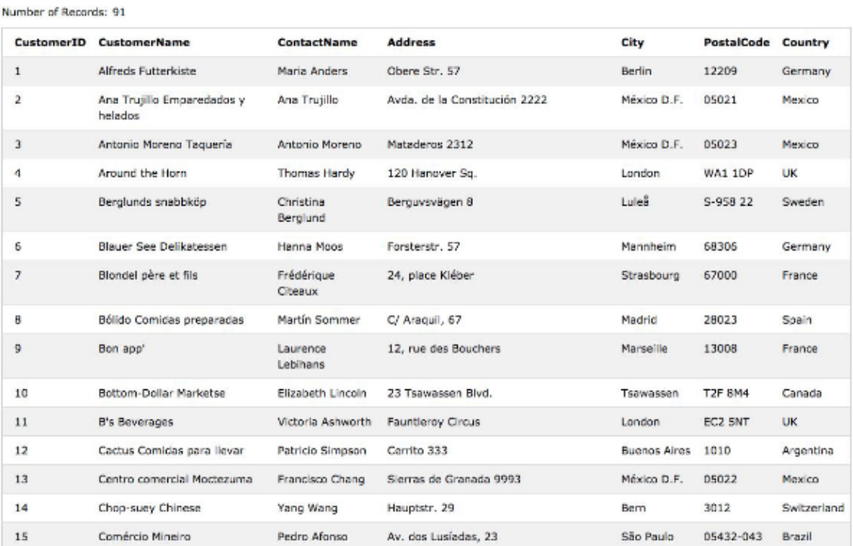
Databases
Databases are used when
Our data won’t fit in memory
We still want fast lookup
Imagine I want to separate this into every user in Brazil ->

Slide 4
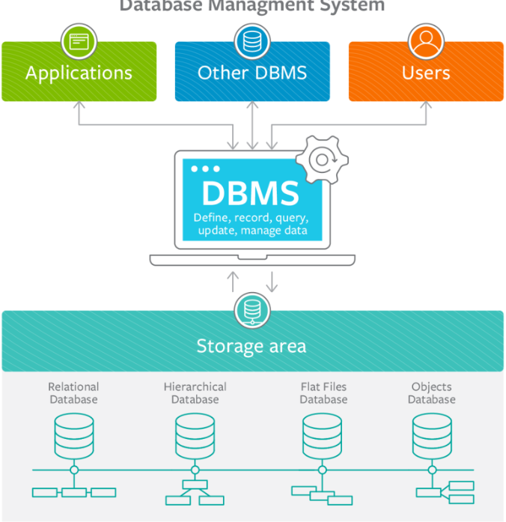
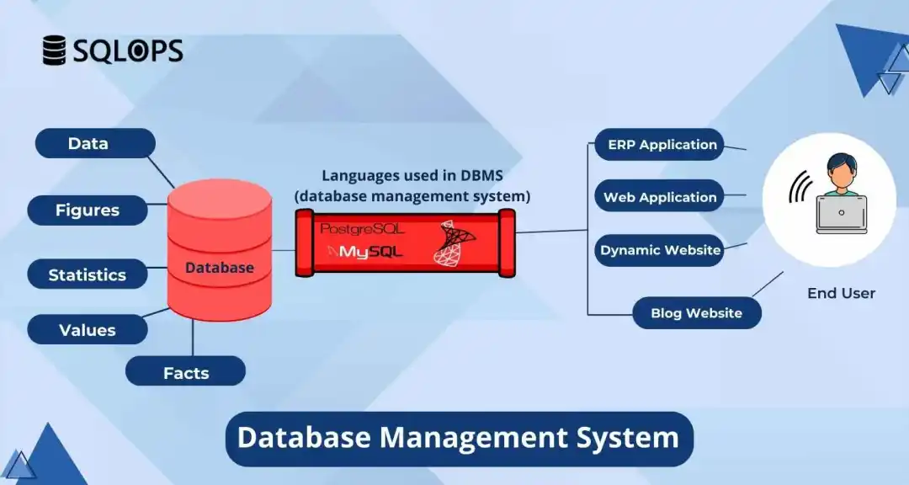
Basic database systems

Slide 5
SQL (STRUCTURED QUERY LANGUAGE)
Do we know how to pronounce it? Ofc not
SQL is how we ask our database questions
Not a programming language!
Going back to our users in Brazil example:
SELECT * FROM customers WHERE country = ‘Brazil’
Wildcard operator
Some conditional
Tells statement to pull info from database
What table we want in from

Slide 6
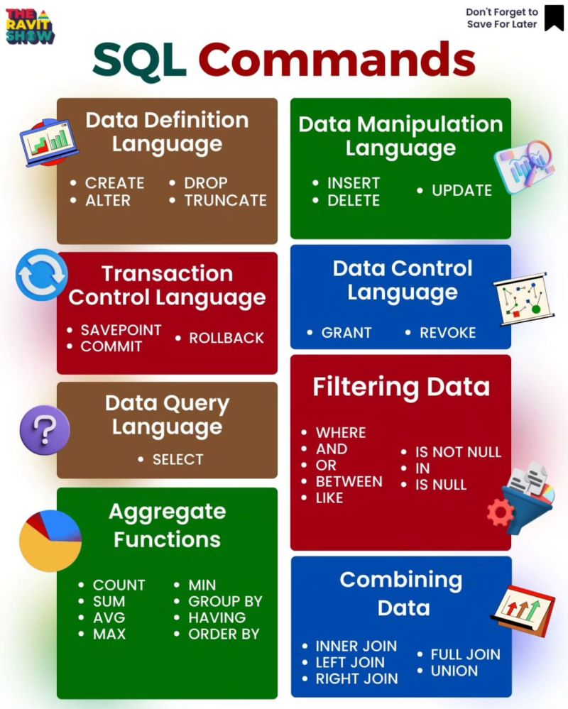
BASIC COMMANDS
SELECT: Retrieve data from table
FROM: Specify table
WHERE: filter on conditions
We’ll be using commands from these categories today!

Slide 7
BASIC COMMANDS CONT’D
ORDER BY: Sorting
Ex: SELECT * FROM table_name ORDER BY column1 ASC
SUM, AVG, MAX, MIN: Exactly what you think they do
Ex: SELECT COUNT(*) FROM table_name
Ex: SELECT AVG(column_name) FROM table_name
GROUP BY: Grouping rows based on columns
SELECT column1, COUNT(*) FROM table_name GROUP BY column1
JOIN ON: Combining rows from two tables based on related column
SELECT * FROM table1 JOIN table2 ON table1.id = table2.id

Slide 8
RESOURCES
Understanding SQL links:
https://mode.com/sql-tutorial/sql-in-mode
https://www.bmc.com/blogs/dbms-database-management-systems/
https://www.geeksforgeeks.org/sql-cheat-sheet/
https://www.w3schools.com/sql/sql_intro.asp
https://www.youtube.com/watch?v=zpnHsWOy0RY&list=PLP9IO4UYNF0UQkBXlTMSw0CYsxv-GDkkI&ab_channel=w3schools.com
Project ideas:
https://www.dataquest.io/blog/sql-projects/
https://www.reddit.com/r/SQL/comments/o3bzu3/ideas_for_a_sql_project/

Slide 9
COLAB NOTEBOOK
https://colab.research.google.com/drive/1Uby_wfOraeGHpJoNye0MDAMaWhWjwlyn?usp=sharing

